Slide 1
CSC 525 Project
Brett Story and Kyle Falconer

Slide 2
Concept
Demonstrating a finite-state automata (FSM)
Choose between two states
Click on things within scenes
A map of locations and the routes discovered will be shown in the HUD.
Find information about computer science throughout game

Slide 3
Discover benefits as a Software Engineer
High salary at HR office
Relaxed office, people, and dress code
Free food and games at food court area

Slide 4
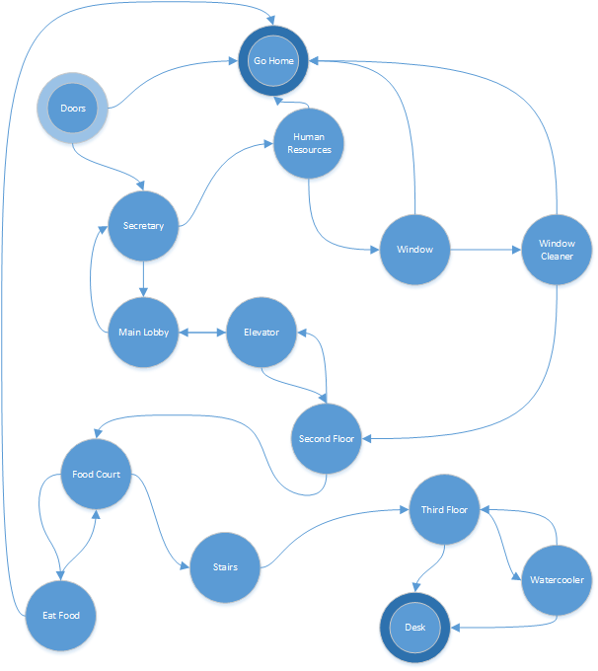
Each state will have two paths (FSM)
Dead state is “Go Home”
End state is “Desk”

Slide 5
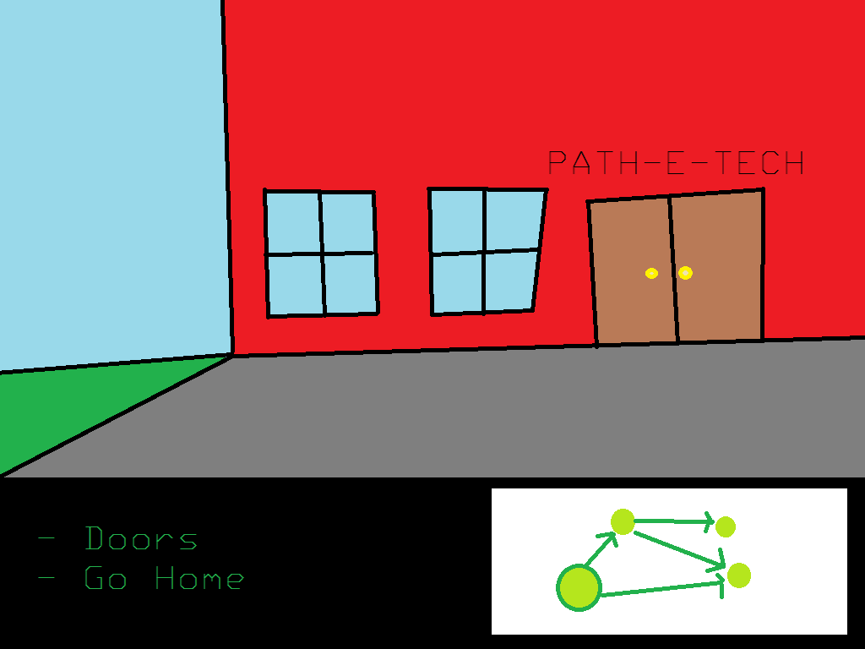
Interface
Heads-up display showing the scene with clickable objects, the two choices, and the map.

Slide 6
Map Functionality
All paths and their destinations seen will be shown.
Current state is highlighted.

